Slide 1
End-to-End Retail SALES Analytics Lakehouse Project (Databricks)

Slide 2
Project Overview
This Project Focuses On Building A Scalable, End-to-end Retail SALES Analytics Platform Using Azure Databricks And The Lakehouse Architecture. The Goal Was To Ingest Raw Retail Data, Process It Using Modern Data Engineering Best Practices, And Expose Clean, Analytics-ready Datasets For Reporting And Downstream Consumption.
The Solution Was Designed With Performance, Scalability, Data Quality, And Governance In Mind, Following Real-world Enterprise Standards Suitable For Client-facing Analytics Use Cases.

Slide 3
Business Problem Statement
Retail data coming from multiple sources (CSV / files)
No centralized analytics-ready system
Manual reporting, slow queries, inconsistent data
No support for incremental loads or historical tracking

Slide 4
Business Objective
The Primary Objectives Of The Project Were:
Centralize Retail Transactional And Master Data
Enable Fast Analytical Queries On Sales And Customer Behavior
Implement A Star Schema For BI And Reporting
Ensure Data Reliability Using Incremental Processing And Deduplication
Build A Foundation That Supports Future Streaming And ML Workloads

Slide 5
High-Level Architecture
Architecture Pattern: Lakehouse With Medallion Architecture
Layers:
Bronze Layer:- Raw Ingested Data (As-is)
Silver Layer:- Cleaned, Standardized And Deduplicated Data
Gold Layer:- Business-ready Dimensional And Fact Tables

Slide 6
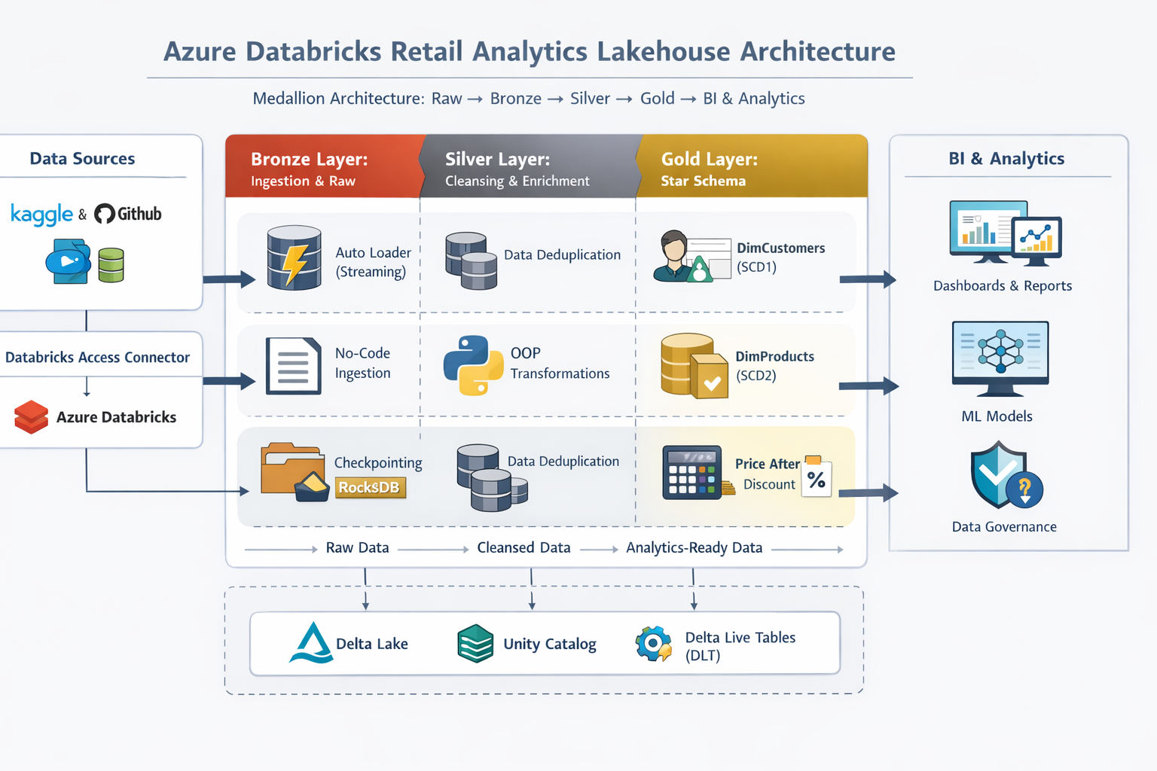
Azure Databricks retail sales architecture

Slide 7
Core technologies used
Core Technologies & Platforms
Azure Data Lake Storage Gen2
Azure Databricks
Delta Lake
Unity Catalog
Data Processing & Frameworks
PySpark
Spark Structured Streaming
Delta Live Tables (DLT)
Auto Loader

Slide 8
Data Engineering Concepts
Incremental Data Processing
Exactly-Once Processing (Idempotent Design)
Slowly Changing Dimensions (SCD Type 1 & Type 2)
Programming & Governance
Python (Object-Oriented Programming)
Unity Catalog Functions & Access Control / Access Management

Slide 9
CLOUD & PLATFORM SETUP
Environment Setup
Created Azure & Databricks accounts
Configured ADLS Gen2
Created Databricks Access Connector
Assigned Storage Blob Data Contributor (Managed Identity)
Governance Setup
Created Metastore (1 per region)
Enabled Unity Catalog
Allowed Databricks to manage tables via ADLS path

Slide 10
UNITY CATALOG & STORAGE DESIGN
Unity Catalog Structure
Catalog: rsa_cata
Schemas: bronze, silver, gold
External Locations: raw / bronze / silver / gold
Storage Credential: rsa_cred
Why This Matters
Centralized metadata
Fine-grained access control
Clear environment separation

Slide 11
Data Sources & Ingestion
Data Sources
Publicly available retail datasets (Kaggle, GitHub)
Ingested into Azure Data Lake Storage Gen2 (Raw layer)
Ingestion Approaches
No-code ingestion for reference tables (Region)
Auto Loader (Streaming) for transactional data using dynamic notebok
Why Auto Loader?
Incremental file discovery
Schema inference
Fault-tolerant ingestion

Slide 12
BRONZE LAYER (RAW → STRUCTURED)
Bronze Layer Purpose
Store raw data
Key Implementation
Spark Structured Streaming
Auto Loader
Checkpointing with RocksDB
Schema inference stored in schemaLocation
Best Practices Followed
Schema location inside checkpoint folder
Separate checkpoint per source

Slide 13
INCREMENTAL INGESTION MECHANICS
Auto Loader Internals
Checkpoint tracks processed files
RocksDB stores:
  Aggregation state
  Deduplication state
  Window state
Dynamic Ingestion
One notebook
Multiple tables (customers, orders, products)
Controlled using dbutils.widgets

Slide 14
SILVER LAYER (BUSINESS-READY DATA)
Silver Layer Purpose
Clean, standardized, enriched data
Key Transformations
Deduplication
Type casting
Null handling
Derived columns (Year, Month)
Advanced Design
Used Python OOP (Window Functions)
Define transformations once
Reused across datasets

Slide 15
DOMAIN-SPECIFIC ENHANCEMENTS
Customer Enhancements
Extracted email domain using split()
Performed domain-level aggregation to determine the top three domains
Product Enhancements
Created scalar functions (using both SQL & Python)
Calculated price after discount
Outcome
Business-friendly attributes
Ready for analytics & reporting

Slide 16
GOLD LAYER OVERVIEW
Gold Layer Objective
Analytics-ready, optimized datasets
Star Schema modeling
Tables Created
DimCustomers (SCD1)
DimProducts (SCD2 via DLT)
FactOrders

Slide 17
DIMCUSTOMERS (SCD TYPE 1)
Strategy
Initial Load (Flag = 1)
Incremental Load (Flag = 0)
Key Steps
Removed duplicates using customer_id
Generated surrogate key using monotonically_increasing_id()
Used MERGE / UPSERT logic
Result
Latest customer state always available

Slide 18
DIMPRODUCTS (SCD TYPE 2 USING DLT)
Why SCD2?
Track historical price/category changes
Implementation
Used Delta Live Tables
Managed versioning automatically
Start & End timestamps
⚠️ Important Note
All-purpose & serverless clusters must be stopped before running DLT

Slide 19
FACTORDERS TABLE
Fact Table Design
Joined:
  Orders (Silver)
  DimCustomers (Gold)
  DimProducts (Gold)
Measures
Quantity
Total Amount
Load Strategy
Incremental UPSERT
Referential integrity ensured

Slide 20
DATA QUALITY & EXPECTATIONS
Data Quality Controls
Applied DLT Expectations
Similar to SQL constraints
Examples
Non-null checks
Valid value checks
Business rule enforcement

Slide 21
FINAL OUTCOMES
What Was Achieved
Fully governed Lakehouse
Incremental & scalable ingestion
Clean star schema
Historical tracking with SCD
Analytics-ready Gold layer
Business Impact
Faster reporting
Reliable data
Easy BI integration

Slide 22
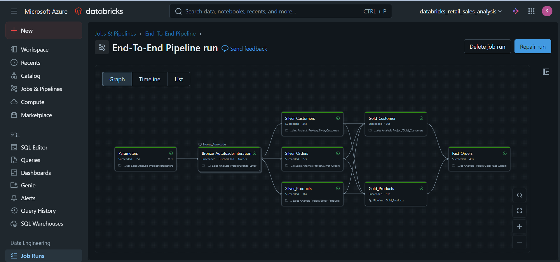
End-to-End Databricks Lakehouse Pipeline Execution

